Slide 1
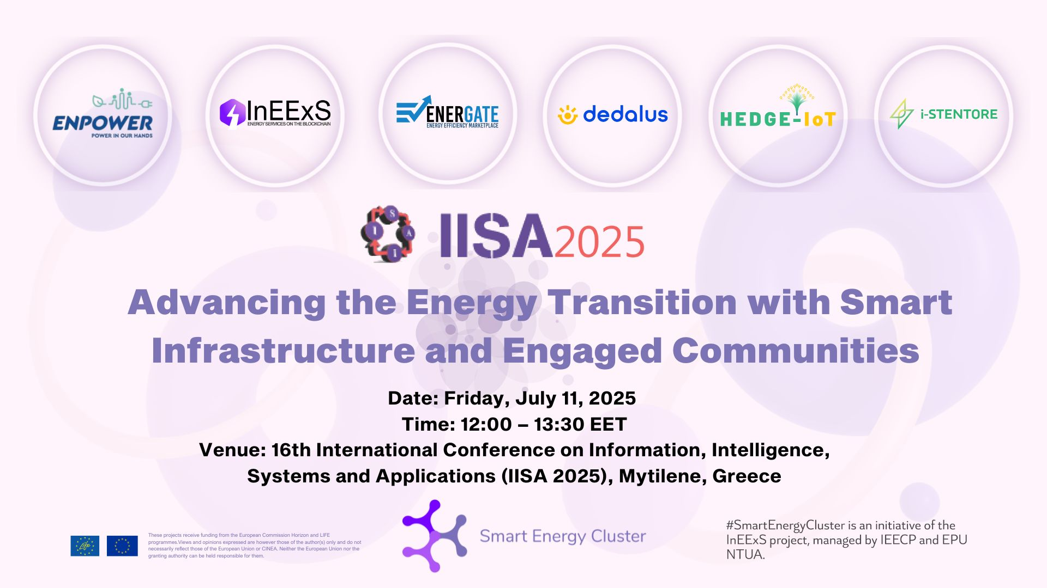
Introduction and Welcome: Katerina Papapostolou (NTUA)

Slide 2
Agenda
13:00 Welcome and overview Katerina Papapostolou (NTUA)
Session 1 - Empowering Citizens in the Energy Transition: Innovative Models, Technologies & Communities
13:10 ENPOWER, Christine Gritsch (Blueprint Energy Solutions)
13:15 InEExS, Filippos Anagnostopoulos (IEECP)
13:20 DEDALUS, Alessandro Rossi (ENG)
13:25 Panel discussion Session 1 – moderated by Katerina Papapostolou (NTUA)
Session 2 - Accelerating Energy Transition: Digital platforms, Storage Integration, and IoT Intelligence
13:50 ENERGATE, Eleni Stigka, (Greenesco)
13:55 HEDGE-IoT, Tudor Cioara (Technical University of Cluj-Napoca)
14:00 i-STENTORE, Vagia Gaidatzi (CluBE)
14:05 Panel discussion Session 2 – moderated by Katerina Papapostolou (NTUA)
14:30 End of the Workshop
Notes:
The workshop begins at 13:00 with a welcome and overview by me. Session 1 focuses on empowering citizens in the energy transition through innovative models, technologies, and communities. Presentations in this session include ENPOWER by Christine Gritsch, InEExS by Filippos Anagnostopoulos, and DEDALUS by Alessandro Rossi, followed by a panel discussion moderated by me as well. Session 2 centers on accelerating energy transition via digital platforms, storage integration, and IoT intelligence, featuring ENERGATE by Eleni Stigka, HEDGE-IoT by Tudor Cioara, and i-STENTORE by Vagia Gaidatzi. This session concludes with another panel discussion. The workshop ends at 14:30.

Slide 3




Who we are
#SmartEnergyCluster is an initiative of the InEExS project
  The core concept of the LIFE project InEExS is the deployment of integrated energy services across sectors and carriers, and the tokenisation of energy saving data in a public blockchain
Managed by IEECP and EPU NTUA
It has currently 34 EU (LIFE and Horizon 2020) projects
Co-funded by the European Union under project ID101077033. Views and opinions expressed are however those of the author(s) only and do not necessarily reflect those of the European Union or CINEA. Neither the European Union nor the granting authority can be held responsible for them.
#SmartEnergyCluster is a collaborative effort of more than 20 EU projects focused on merging different energy services and incorporating non-energy benefits whilst overcoming market fragmentation and fostering cooperation. This inclusive approach bridges gaps and creates a common ground for business development across different segments.
Notes:
The SmartEnergyCluster is an initiative that was established within the framework of the InEExS project, which deploys integrated energy services across various sectors and carriers and works on the tokenisation of energy-saving data on a public blockchain. The cluster is managed by IEECP and EPU NTUA, and it currently consists of 34 projects funded by the EU through LIFE and Horizon 2020 programme. Our collaborative effort aims to merge different energy services, incorporate non-energy benefits, and overcome market fragmentation.

Slide 4





Purpose of the cluster
Establish synergies among projects with common topics of interest and KPIs.
Exchange knowledge in aspects of dissemination and communication activities and stakeholder engagement.
Take advantage of our combined experience, know-how and active participation with the scope of successfully promoting our projects.
Join our forces and work together in the framework of the dissemination, communication and exploitation of our projects activities and results, aiming at engaging interested and common target groups and multiplying our messages.
Define a common strategy building on cross-promotion, joint events and other collaboration activities that we can define together.
Notes:
The main purpose of the #SmartEnergyCluster is to establish synergies among projects that share common topics and key performance indicators. We aim to exchange knowledge, particularly in the areas of dissemination, communication, and stakeholder engagement. By leveraging our collective experience and expertise, we can more effectively promote our projects and achieve greater impact. Our goal is to define a common strategy that involves cross-promotion, joint events, and collaborative activities. This unified approach allows us to engage target groups more effectively and amplify our message about the importance of the energy transition.

Slide 5
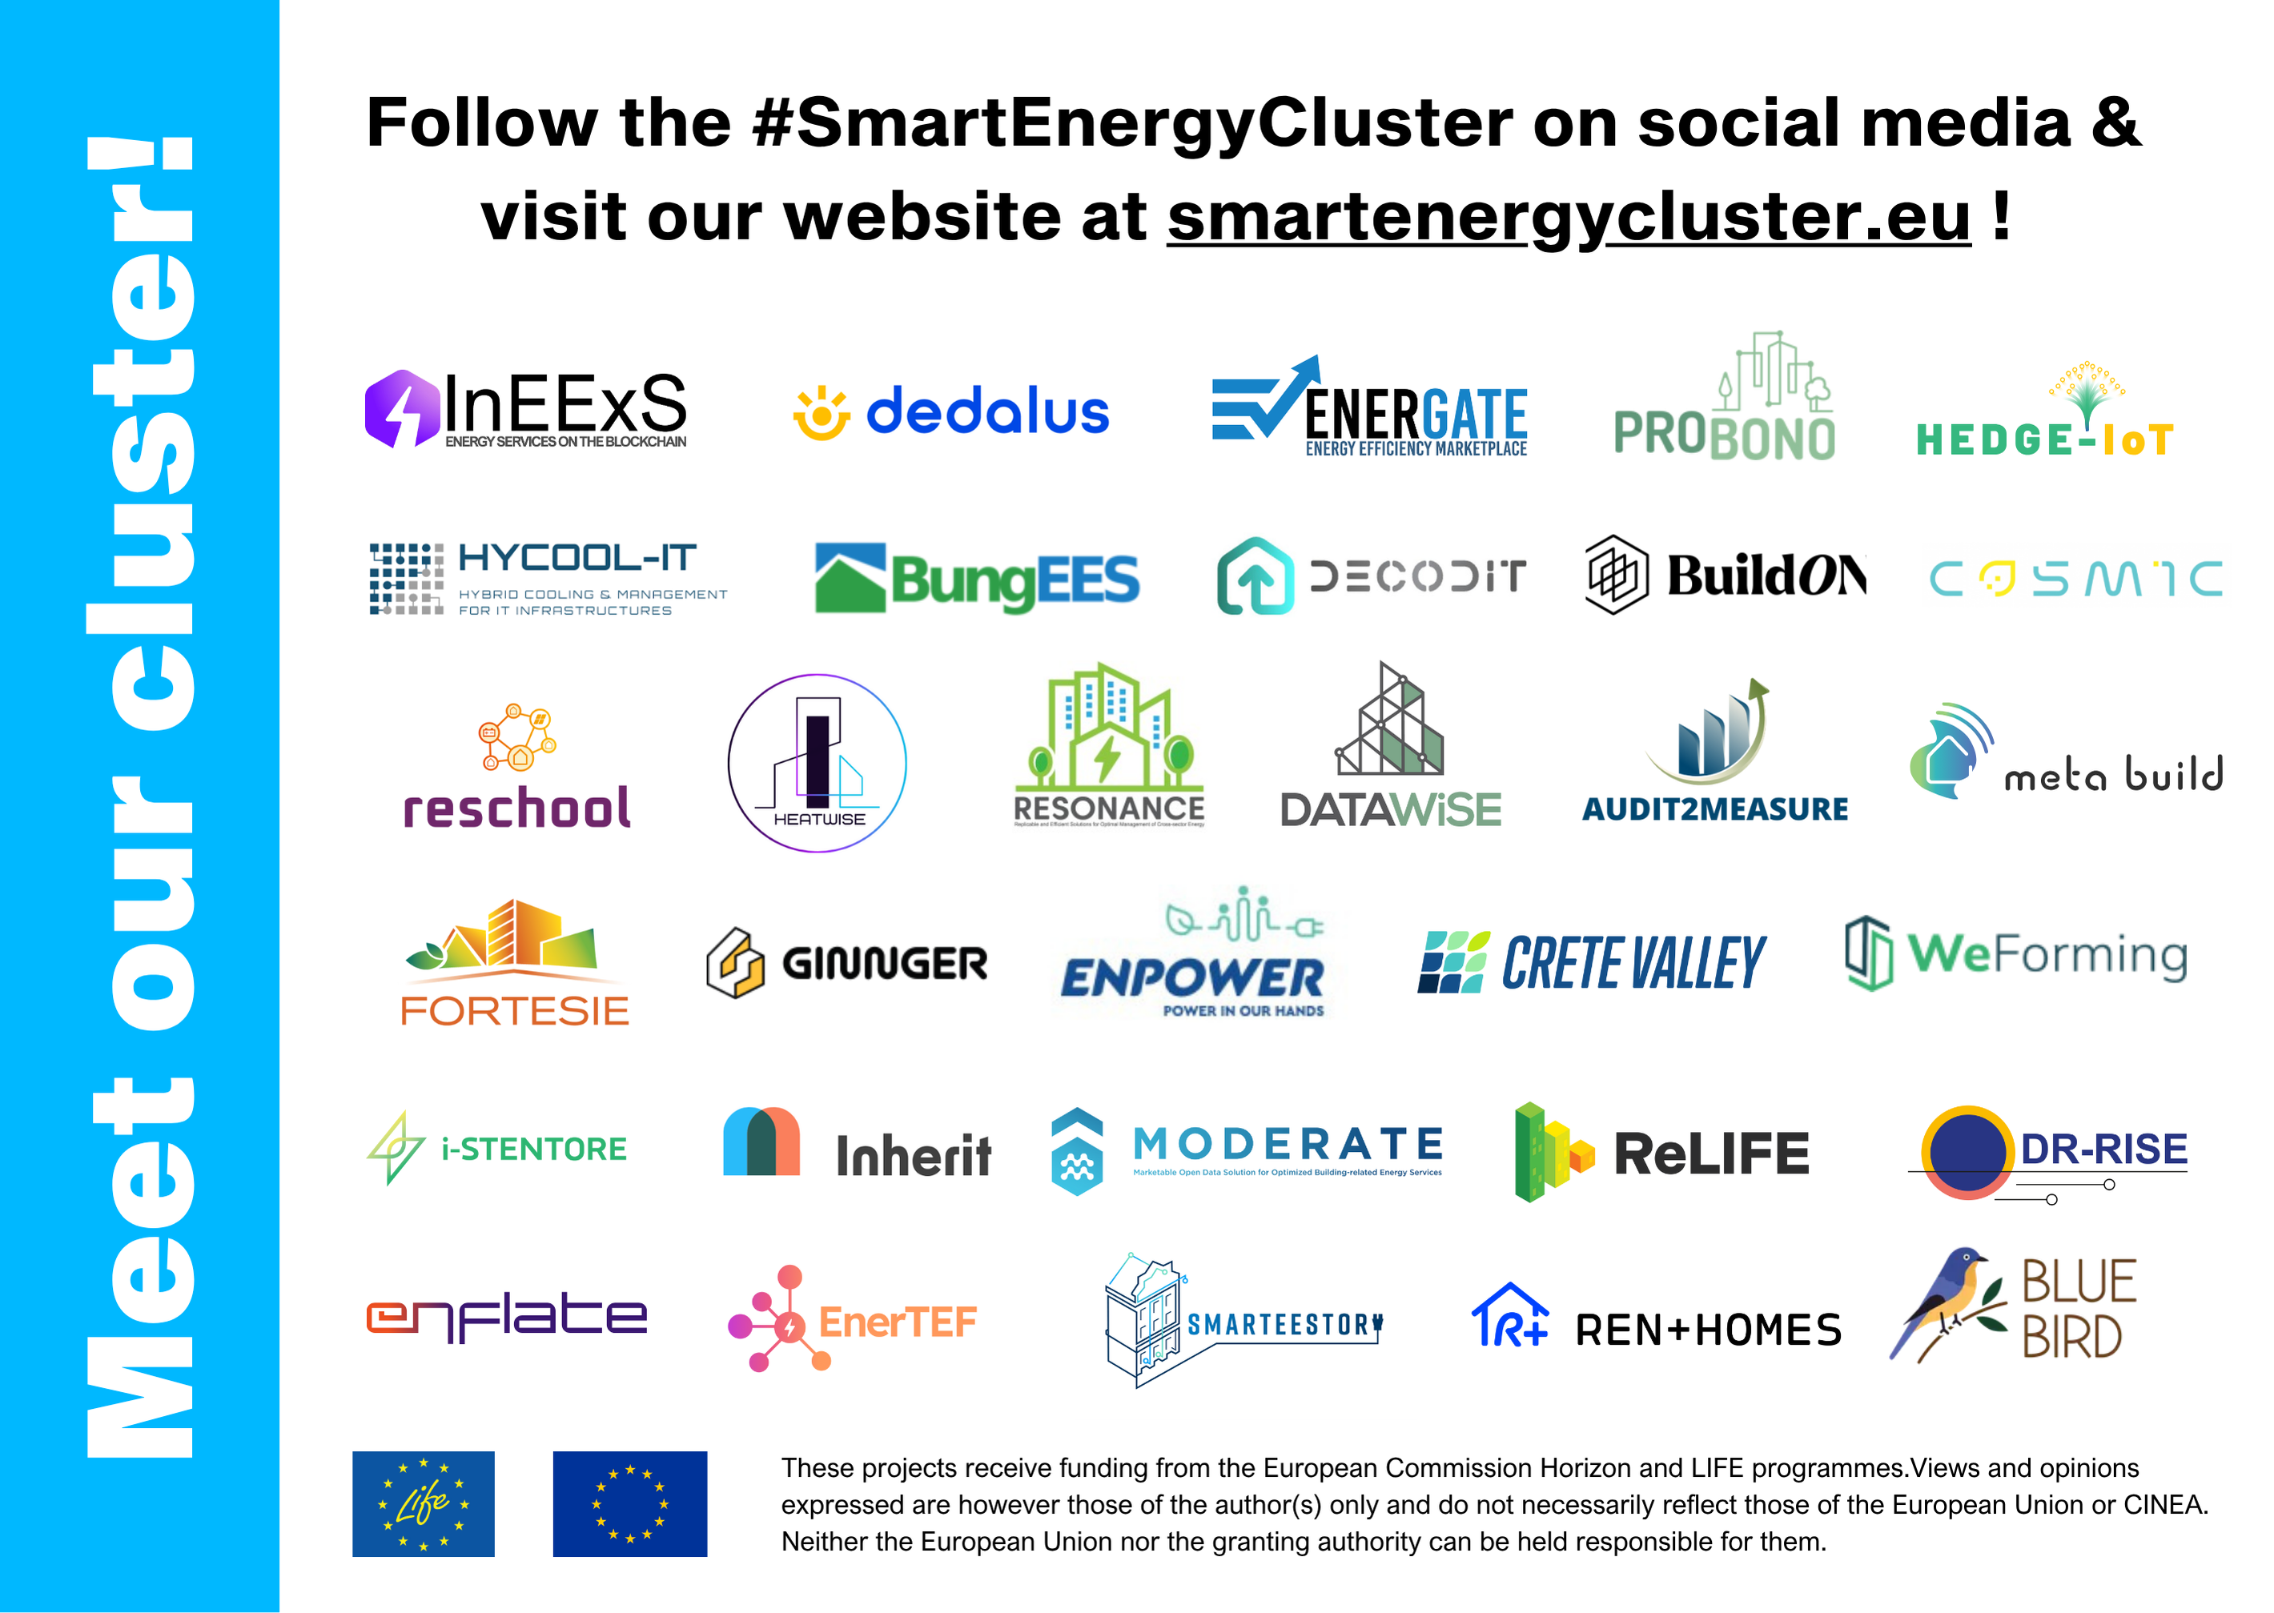
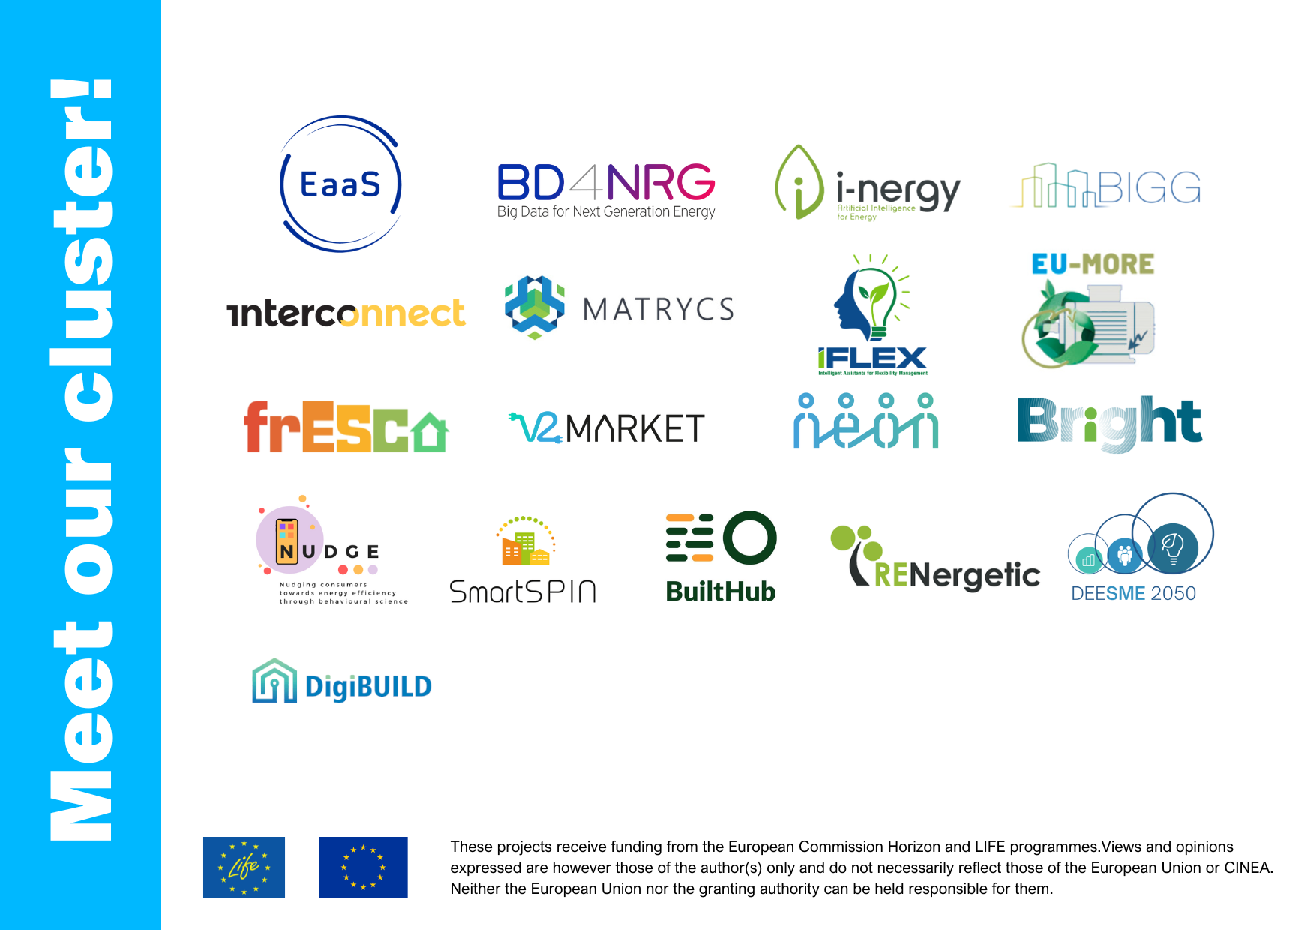
#SmartEnergyCluster Projects
The cluster has 34 Ongoing Projects and 18 Ended Projects
Ongoing
Ended
Notes:
Our cluster currently has 34 ongoing projects and 18 completed projects, covering a wide range of topics within the energy sector. Several of these cluster projects originated through SmartSPIN’s earlier clustering activities, establishing a foundation for continued collaboration and growth. By grouping projects with similar fields of activities, we can foster bilateral synergies, not only in technical aspects but also in organizing events and developing content and materials.
The diversity of these projects enriches the cluster, bringing various perspectives and innovative solutions to the forefront of the energy transition. This diversity also facilitates mutual learning, enabling the development of new approaches to energy efficiency and further strengthening the link between past and current initiatives.

Slide 6
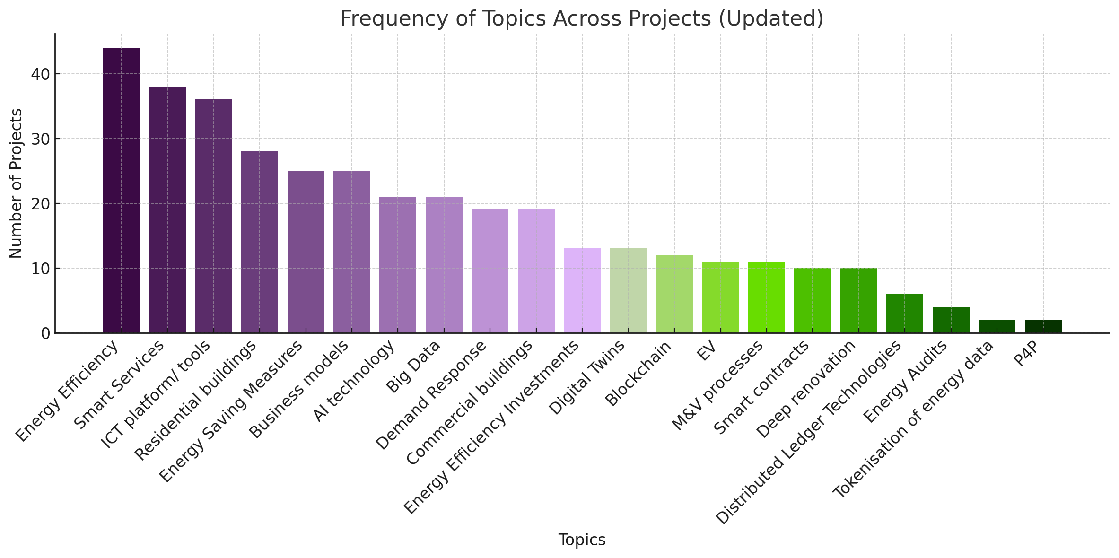
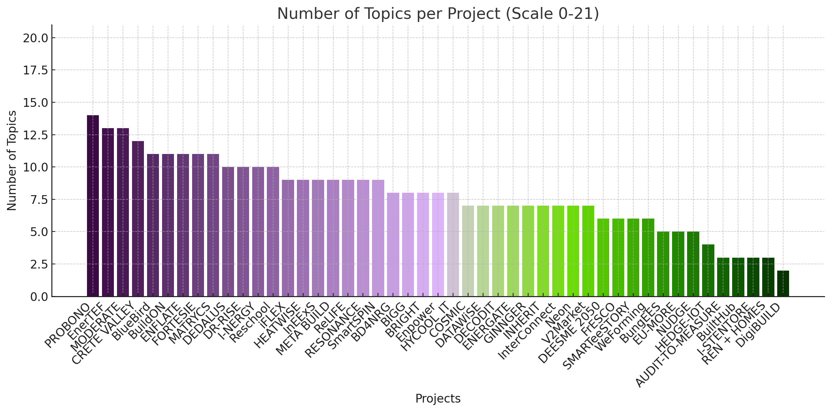
Cluster topics
21 topics identified through research in order to group projects.
All projects are requested to fill in the application form.
Filtering capabilities for identifying commonalities and similar fields of activities among the projects.
This helps in creating bilateral synergies in technical aspects but also events organisation or material development.
Energy Efficiency stands at the core of the cluster, with other topics varying in importance, represented from left
Notes:
We identified 21 topics to categorise our projects, which helps us understand their focus areas and find common ground. Projects are requested to fill out an application form detailing their activities, allowing us to filter and identify commonalities. At the core of the cluster is energy efficiency, which serves as a focal point. Around this core, we have various other topics, each varying in importance. By grouping our projects in this way, we can foster more targeted collaborations and tackle specific challenges in the energy sector.

Slide 7
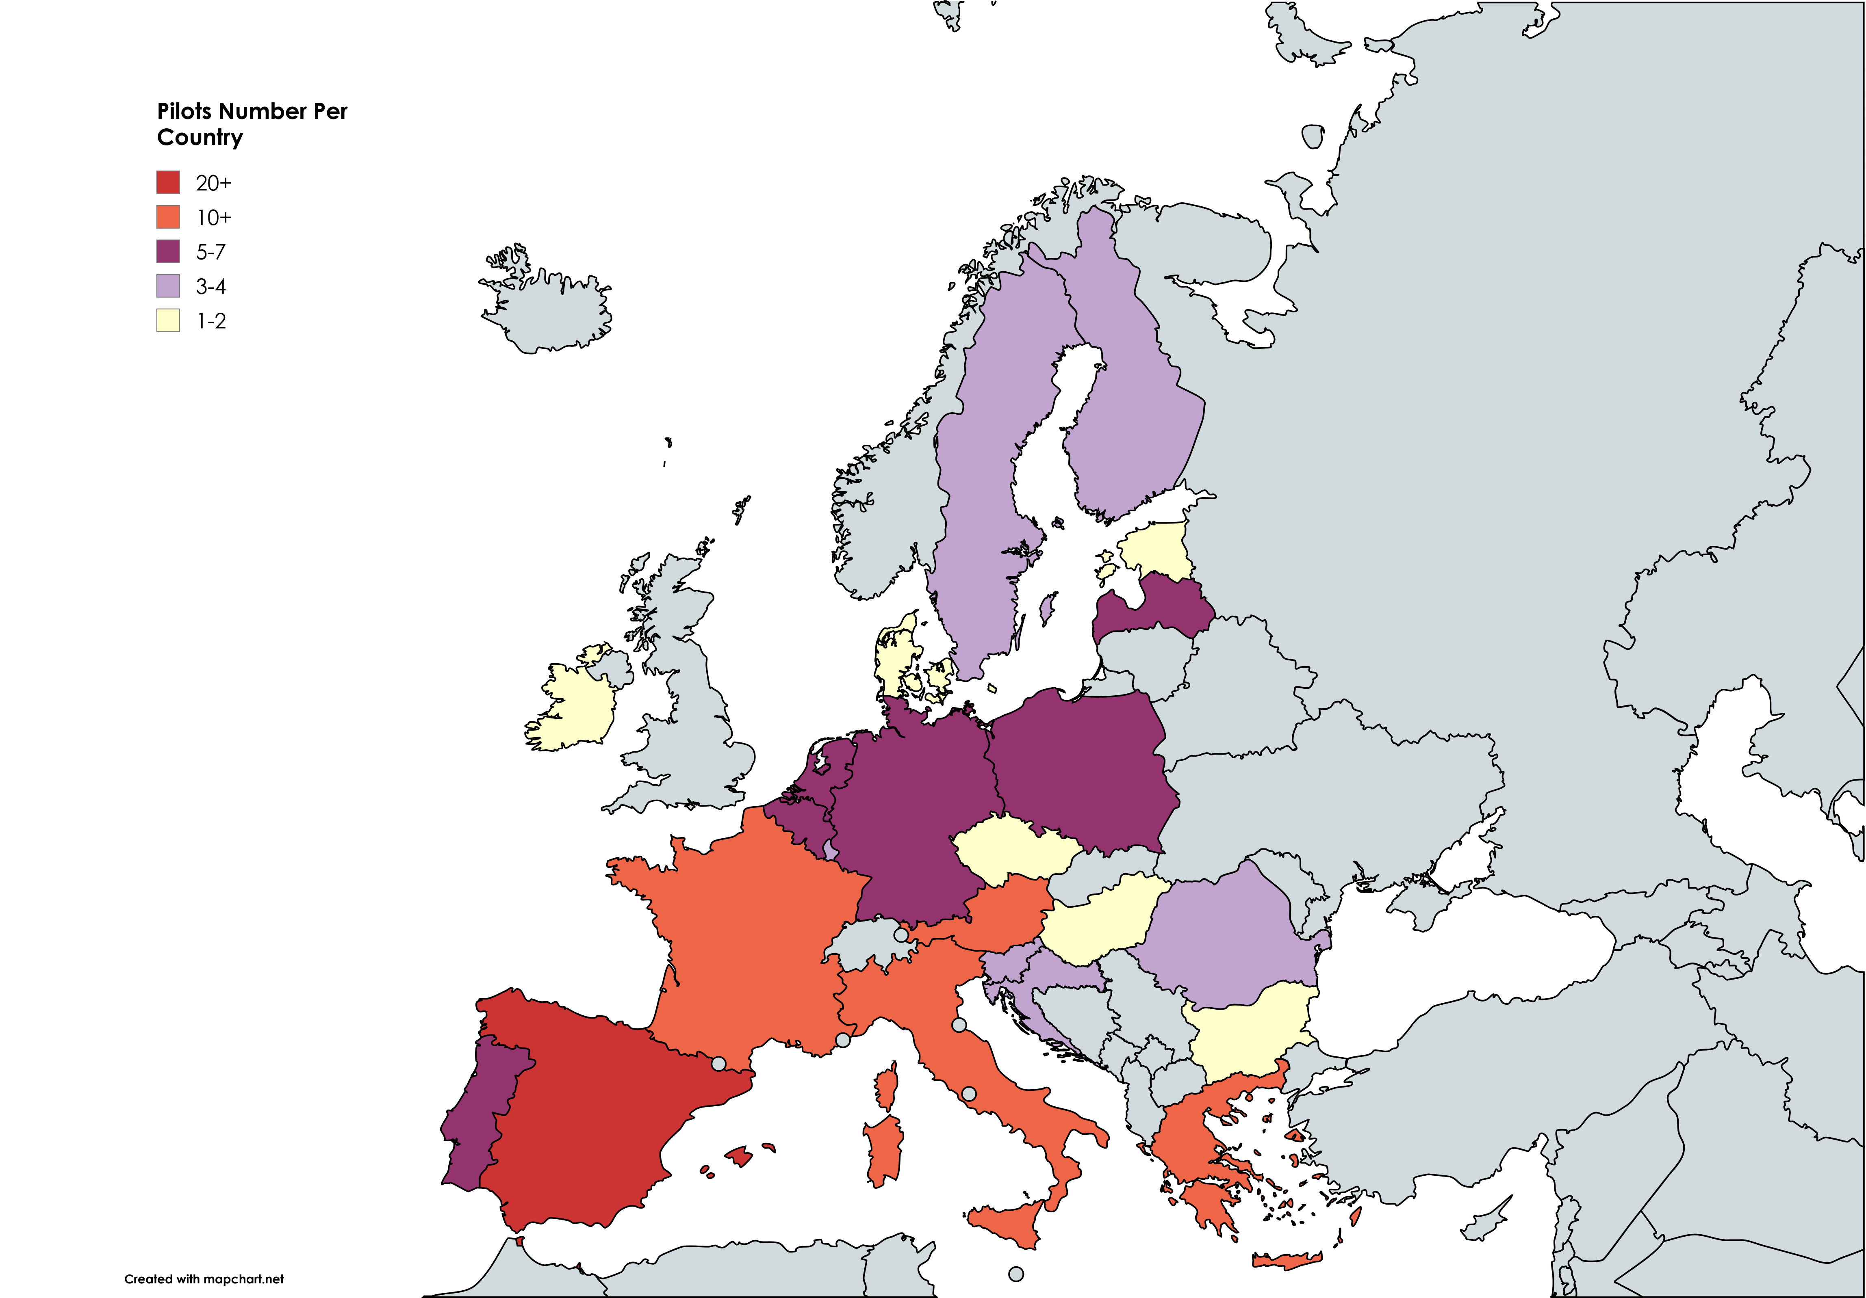
Cluster Pilot Countries
Most Pilots in Greece, Italy and Spain
3 Pilots from other countries in Europe (not in EU Zone)
Many pilots across 30 different countries that bring unique expertise in the #SmartEnergyCluster
Notes:
Our cluster features pilot projects across numerous countries, with most pilots concentrated in Greece, Italy, and Spain. In total, we have pilots in 30 different countries, each bringing unique expertise and perspectives to the #SmartEnergyCluster. This geographic diversity is one of our strengths, allowing us to test and implement solutions in a variety of contexts and environments and collaborate in national level as well.

Slide 8
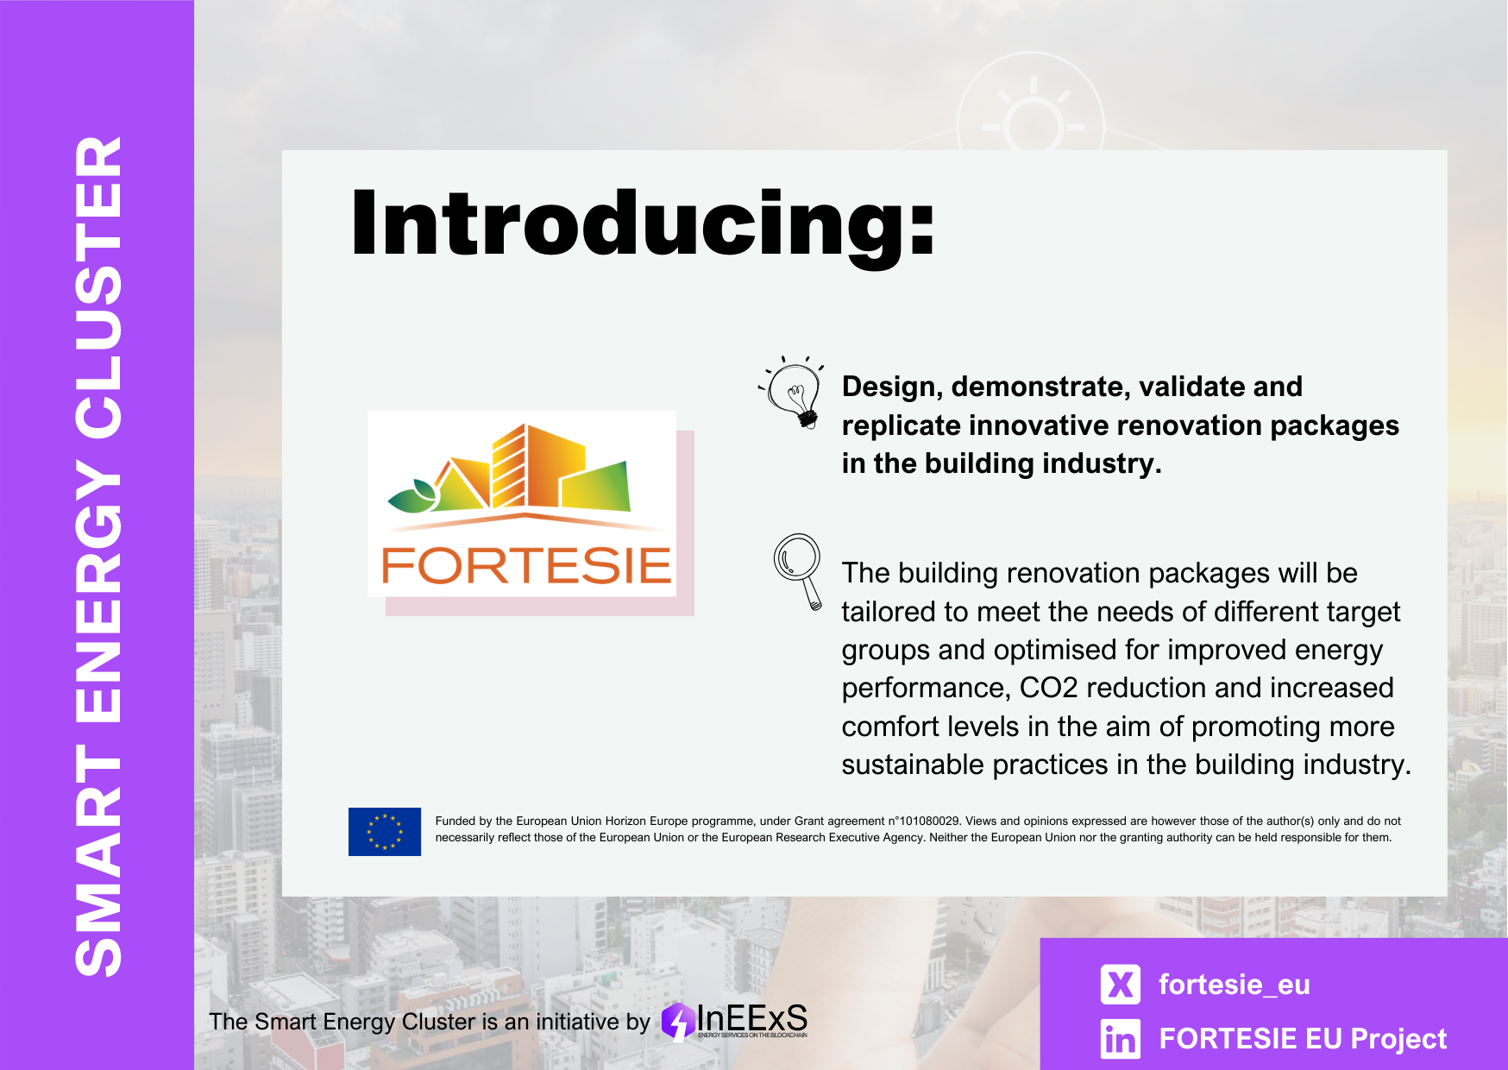
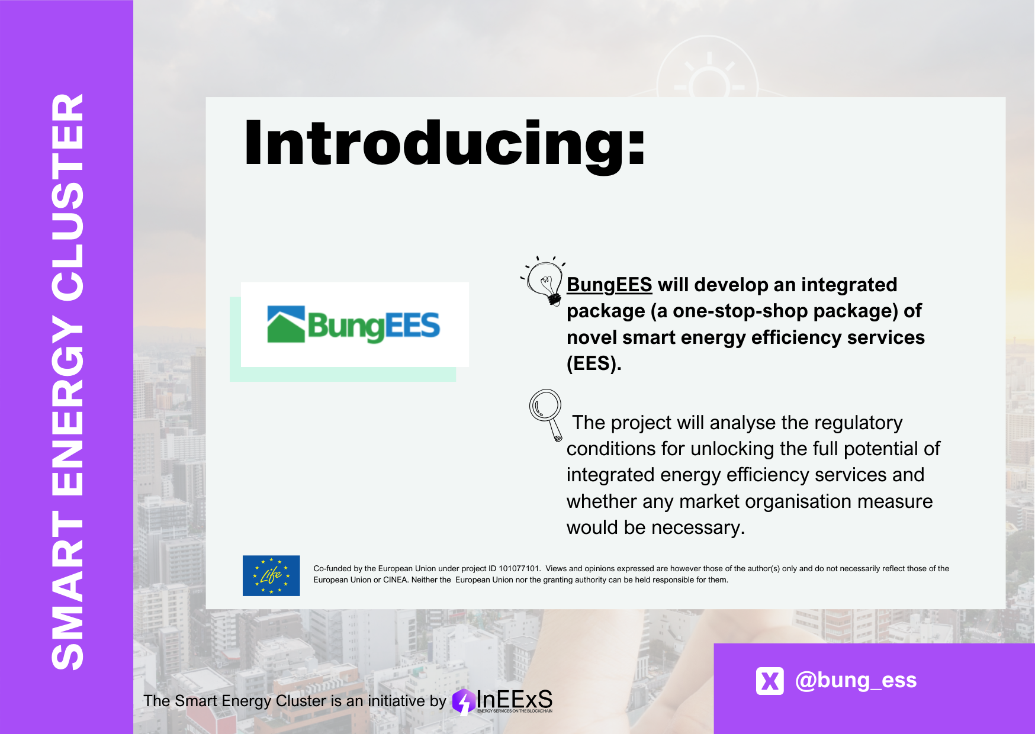
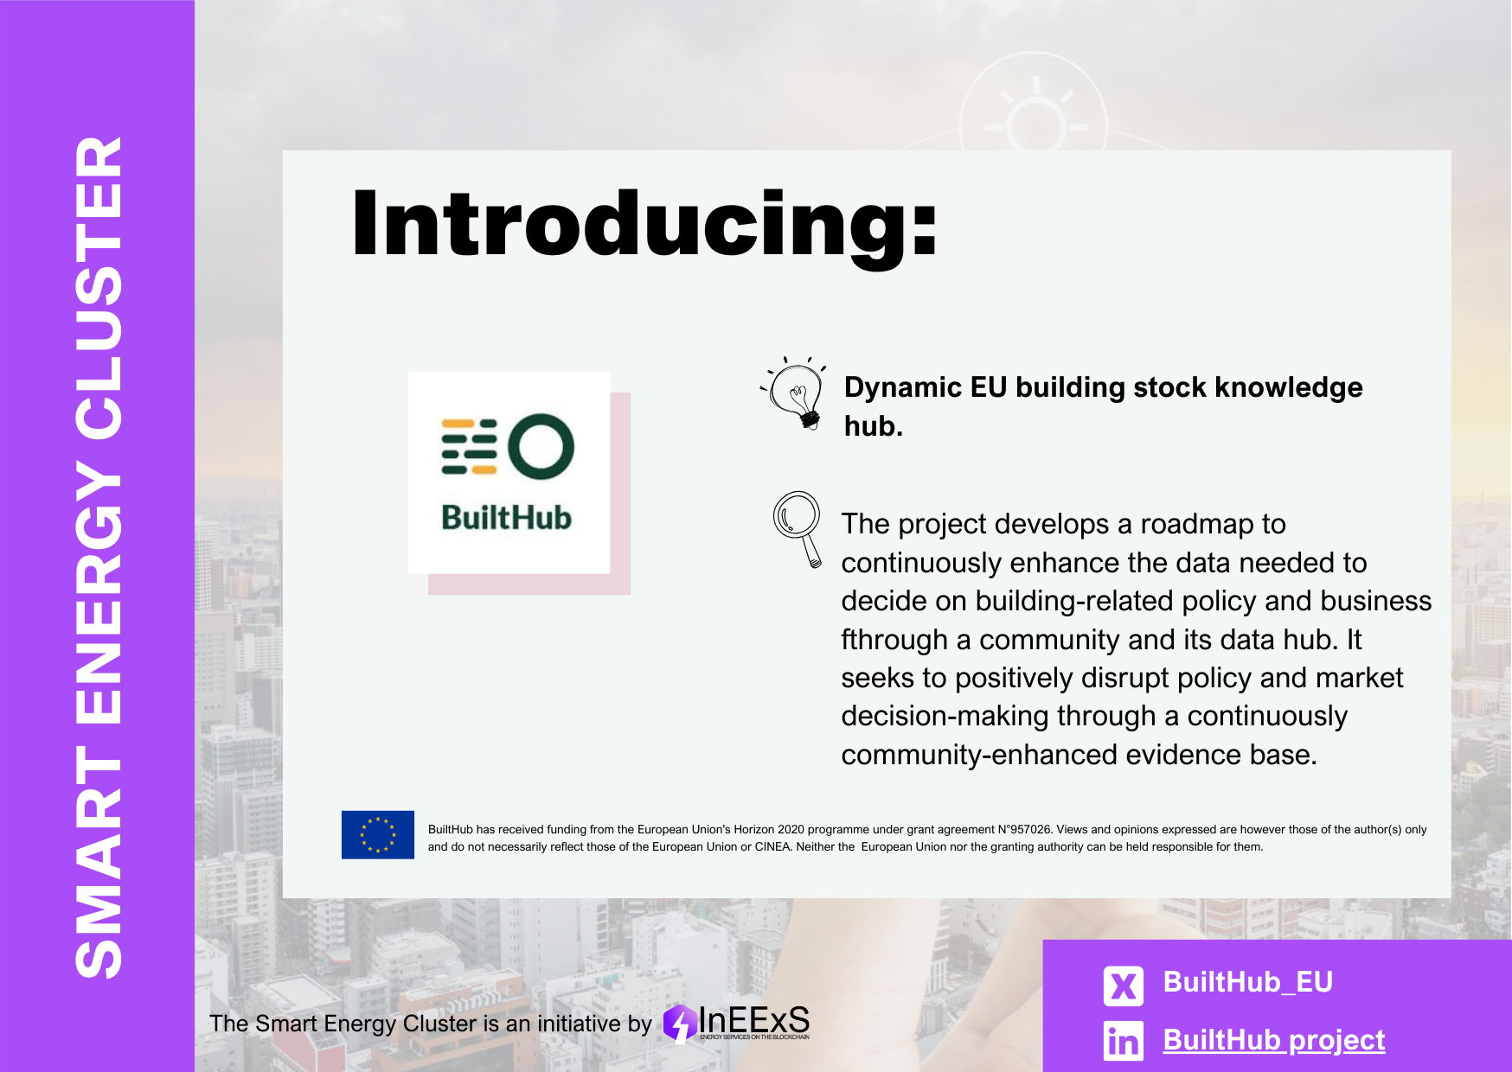
Social media campaigns
#SmartEnergyCluster
#MeetourSmartEnergyCluster
Notes:
To spread the word about our activities and the importance of the energy transition, we have an active presence on social media. We use hashtags like #SmartEnergyCluster and #MeetourSmartEnergyCluster to create awareness and foster engagement. Our campaigns are designed to highlight the collaborative nature of our cluster and to introduce our member projects to a broader audience.

Slide 9
Social media campaigns
Smart Energy Cluster article
InEExS Promotion of New Projects through Social Media
X or BlueBird: Collaboration is key to the #energytransition!
The #SmartEnergyCluster brings together expertise and resources of 30+ projects to accelerate innovation and deployment of smart energy solutions!
Read more and see how you can get involved: https://ieecp.org/2025/04/15/the-smart-energy-cluster-a-collaborative-force-for-the-energy-transition-getting-stronger-and-bigger/
LinkedIn Post: The #SmartEnergyCluster: A Collaborative Force for the Energy Transition
With 30+ EU projects, the growing #SmartEnergyCluster fosters collaboration to achieve a more sustainable energy future by breaking down market barriers, boosting the benefits of integrated #energyservices for end-users and the environment and highlighting the importance of communication and knowledge sharing for maximising impact.
Are you interested in joining a collaborative force for change? Read more about the #SmartEnergyCluster and see how you can get involved: https://ieecp.org/2025/04/15/the-smart-energy-cluster-a-collaborative-force-for-the-energy-transition-getting-stronger-and-bigger/
Notes:
This slide showcases the social media campaigns promoting the Smart Energy Cluster and its associated projects. The InEExS initiative actively uses social media channels to raise awareness about new projects, encouraging people to follow the hashtag #SmartEnergyCluster and visit the website smartenergycluster.eu for more information. The slide also highlights many projects funded by the European Commission and LIFE programmes that are part of this collaborative cluster. On the right side, you can see examples of social media posts, including a tweet emphasizing that collaboration is key to accelerating the energy transition, and a LinkedIn post highlighting how over 30 EU projects work together within the cluster to overcome market barriers and promote sustainable energy solutions. These campaigns aim to increase the cluster’s visibility, foster knowledge sharing, and invite new stakeholders to join this collective effort. Overall, social media plays a vital role in quickly spreading the message and engaging a wide audience across industry, policymakers, and the public.

Slide 10
Some numbers from the cluster
52 total projects that have been part of the Cluster
34 projects currently part of the Cluster
320 times the #SmartenergyCluster hashtag was used on social media
1 website with application forms to be part of the Cluster and to disseminate news
1 pilot map covering 25 countries
3 Collaboration workshops
9 Joint Events
SharePoint for pushing collaborations with supportive documents to share information and news
Notes:
The Smart Energy Cluster comprises a total of 52 projects, with 34 currently active members. The hashtag #SmartenergyCluster has been used 320 times on social media, reflecting the cluster's online presence. The cluster operates a dedicated website featuring application forms for joining and news dissemination. A pilot map includes coverage of 25 countries, enhancing project visibility across Europe. Collaboration is fostered through 3 workshops and 9 joint events. Additionally, SharePoint is utilized for sharing supportive documents, facilitating collaboration and efficient communication within the cluster.

Slide 11
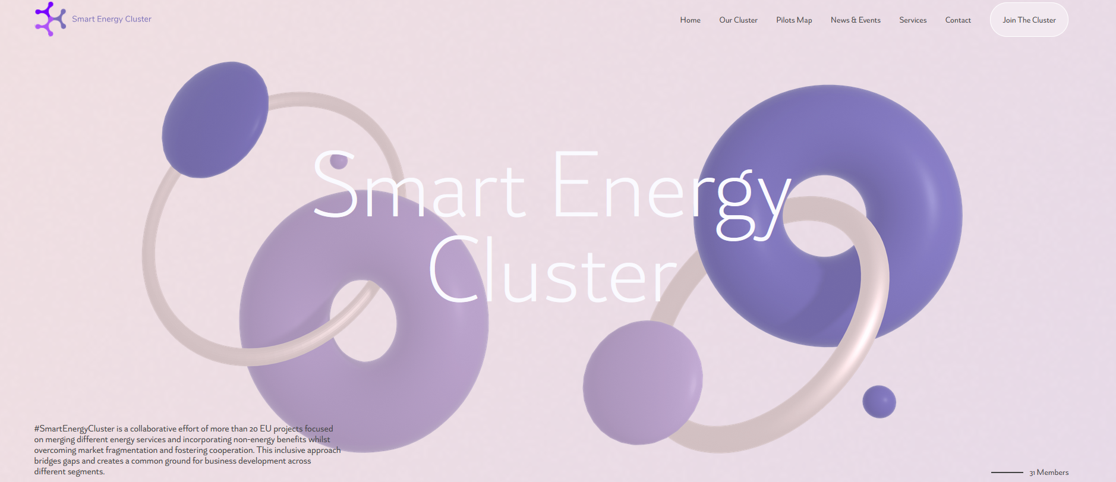
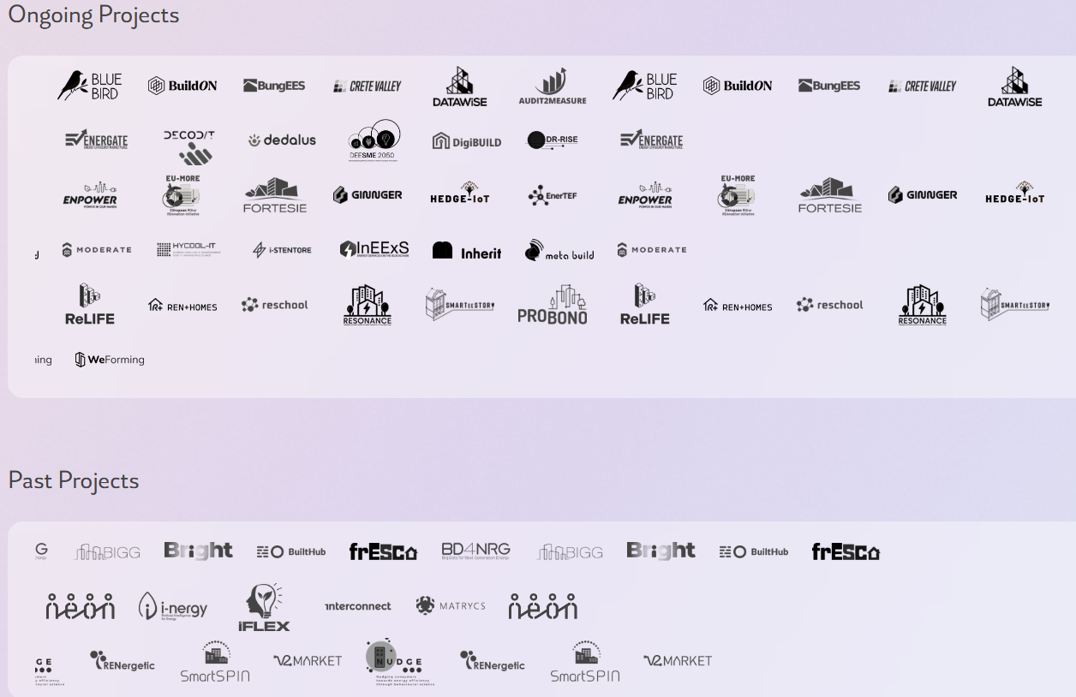
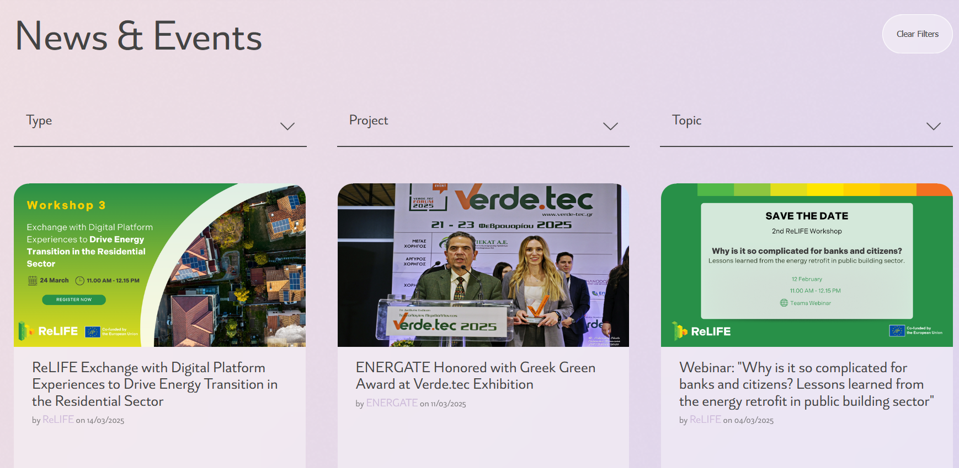
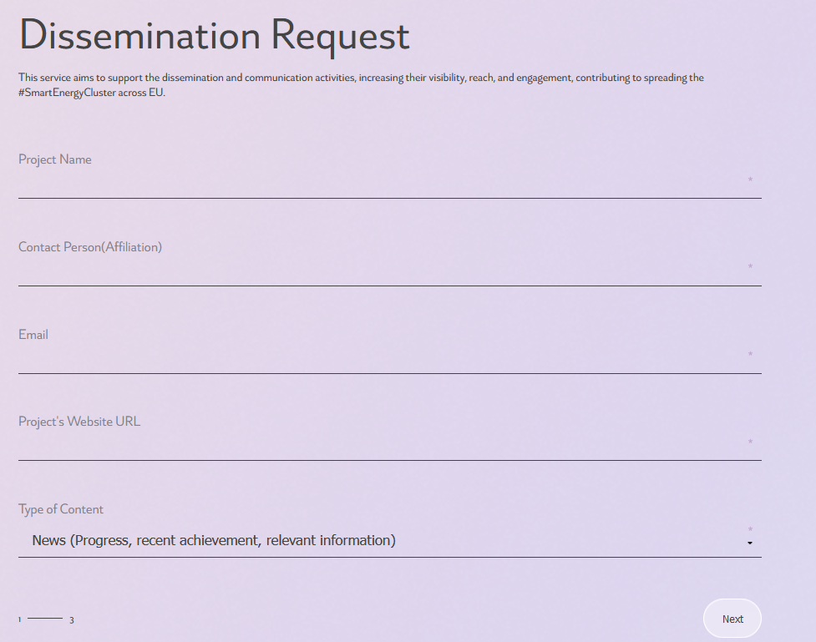
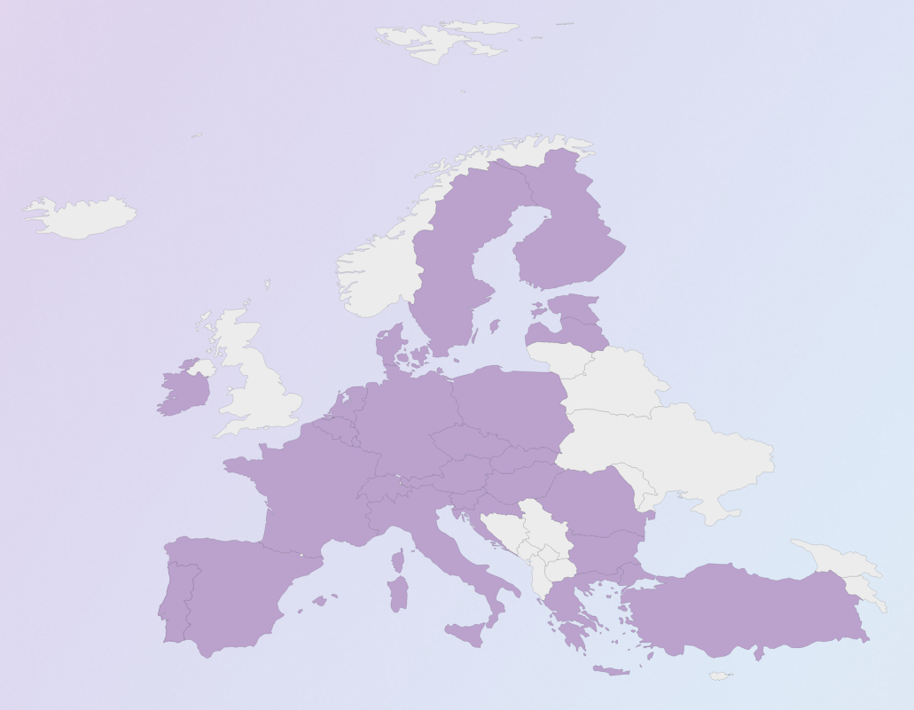
#SmartEnergyCluster Website
Home Page: Information of ongoing projects, cluster goals, latest news and events and cluster coordinators (IEECP and NTUA)
Our Cluster page: Project logos, links to their website
News & Events page: Filter of the information per type and topic
Pilot maps page: The Pilot Visualisation Map displays pilot projects by country, allowing users to filter the view either by project or by country. Once a filter is selected, users can click on individual pilot projects on the map to visit each project's dedicated webpage for more detailed information.
Services page: Information of ongoing projects (social media, website, contact email) and a dissemination request, in which projects can disseminate any activity through the website or/and the social media of InEExS
Join the Cluster: Simple form for any project to join the cluster and use its services. If they are accepted, an email with instructions and detailed information on how to use the cluster is sent.
69 News and Event Items
3,471 Unique Users
Notes:
The Smart Energy Cluster website offers a comprehensive platform to showcase ongoing projects, cluster goals, the latest news and events, and information about cluster coordinators from IEECP and NTUA. The Home Page provides up-to-date details on these aspects to keep users informed. The Our Cluster page features project logos and links to their respective websites, facilitating easy access to individual projects. The News & Events page allows users to filter information by type and topic, enhancing the browsing experience. The Pilot Maps page displays a Pilot Visualisation Map where users can filter projects by country or specific projects, enabling direct access to each pilot project's dedicated webpage for more detailed information. The Services page offers information on ongoing projects, including social media, website, and contact email details, along with a dissemination request feature for projects to share activities through the website or social media of INEExS. Lastly, the Join the Cluster page provides a simple form for projects to join the cluster and utilize its services. Upon acceptance, projects receive an email with instructions and detailed information on how to use the cluster effectively. To date, the platform hosts 69 news and event items and has attracted 3,471 unique users, demonstrating its growing reach and engagement within the energy cluster community.

Slide 12
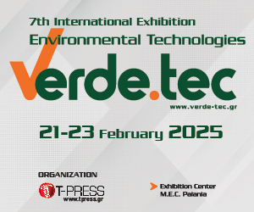
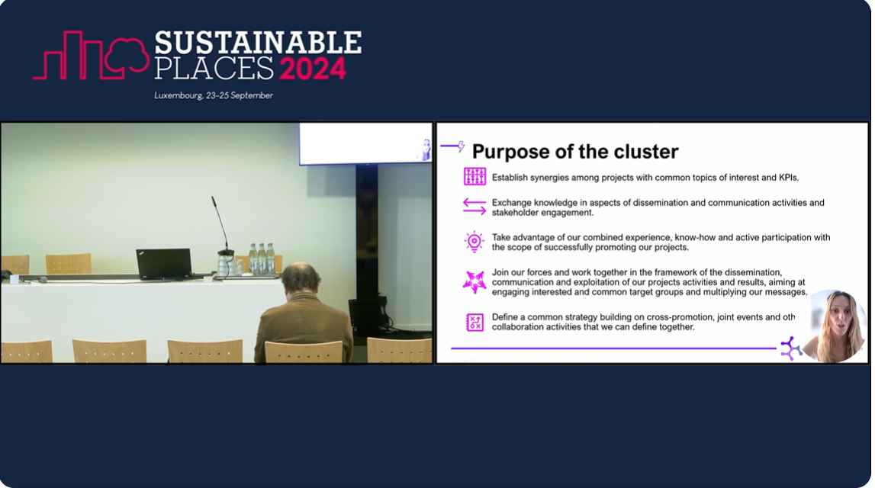
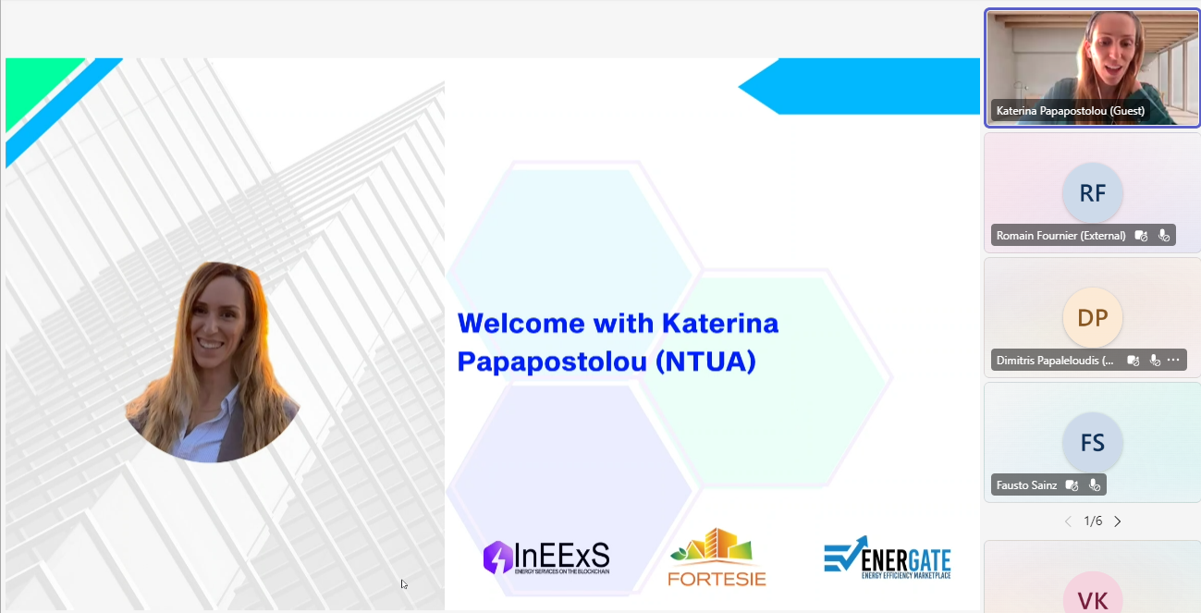
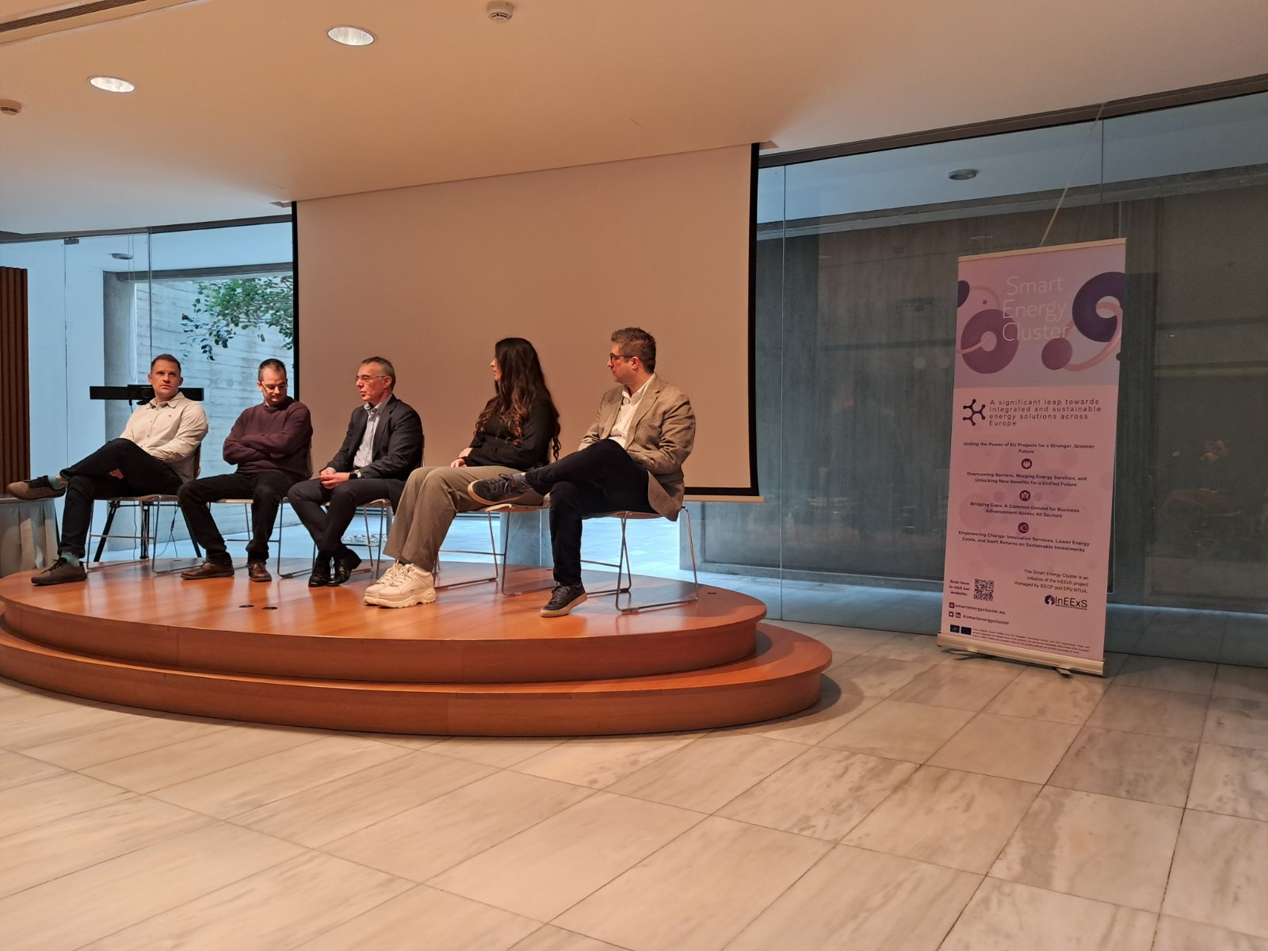
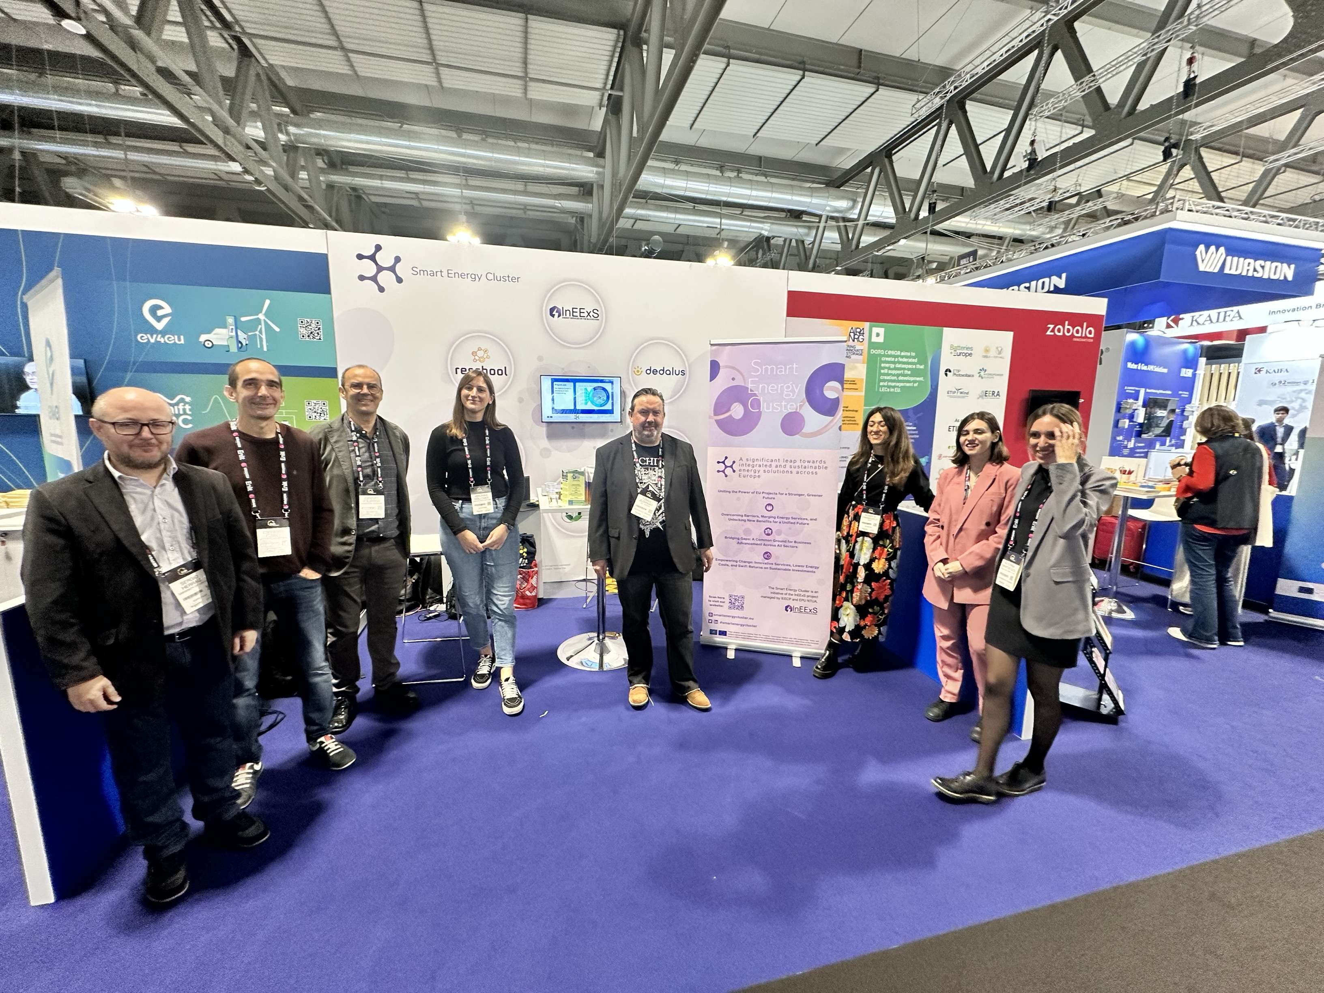
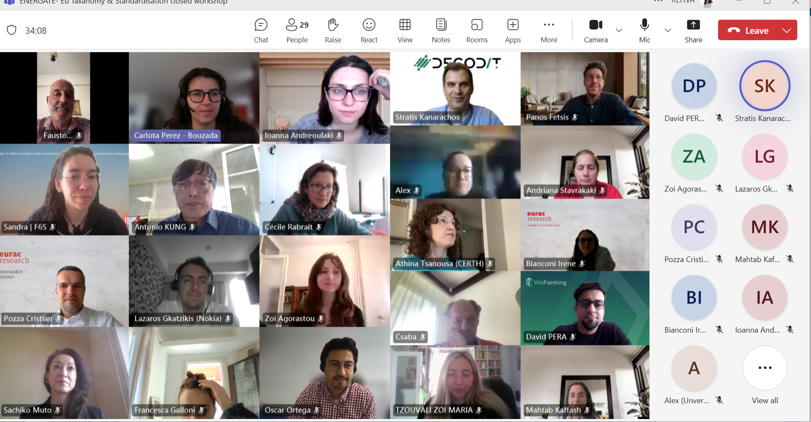
#SmartEnergyCluster Events
Joint events already completed with the Cluster:
  Enlit Europe 2024
  Stand in Enlit Exhibition, Public Event on Unlocking the Power of Smart Energy: A New Era in Efficiency, Flexibility and Innovation with FORTESIE, InEExS, DigiBUILD, RESONANCE, EU-MORE and RESCHOOL Projects.
  3 Smart Energy Cluster Collaboration Workshops
  Presentations of New Projects Joining the Cluster and collaboration opportunities
  Replication Workshops
  InEExS – DigiBUILD Replication Workshop on 4 February 2025 in Athens titled “Digital technologies and energy efficiency in buildings: From theory to practice”
  InEExS – ENERGATE Replication Workshop on 22 February 2025 at Verde.tec International Exhibition titled “From Innovation to Market: Advanced Services for Building Energy Upgrades”
  Webinars
  InEExS – BungEES Webinar on December 2024 titled “Energize Your Business: Innovative Models for a Sustainable Future”
  Sustainable Energy Day 2024
  ENERGATE – InEExS – FORTESIE Webinar titled “From Tech to Transformation: Accelerating Building Energy Efficiency through ICT Solution”
  SmartSPIN Final Event at Sustainable places
  Presentation of Smart Energy Cluster, titled “Innovation through Collaboration: The #SmartEnergyCluster Fueling the Smart Energy Transition from InEExS”
  Standardisation Workshop
  Webinar on EU Standardisation, titled “ENERGATE- Standardisation & EU Taxonomy: closed workshop” with DATAWiSE, DECODIT, DEDALUS, ENERGATE, ENPOWER, HYCOOL_IT, MODERATE, RESCHOOL, RESONANCE & WeFORMING projects
  IISA 2025
  Smart Energy Cluster Workshop, titled “Advancing the Energy Transition with Smart Infrastructure and Engaged Communities” with InEExS, ENPOWER, DEDALUS, ENERGATE, HEDGE-IoT and i-STENTORE projects

Slide 13



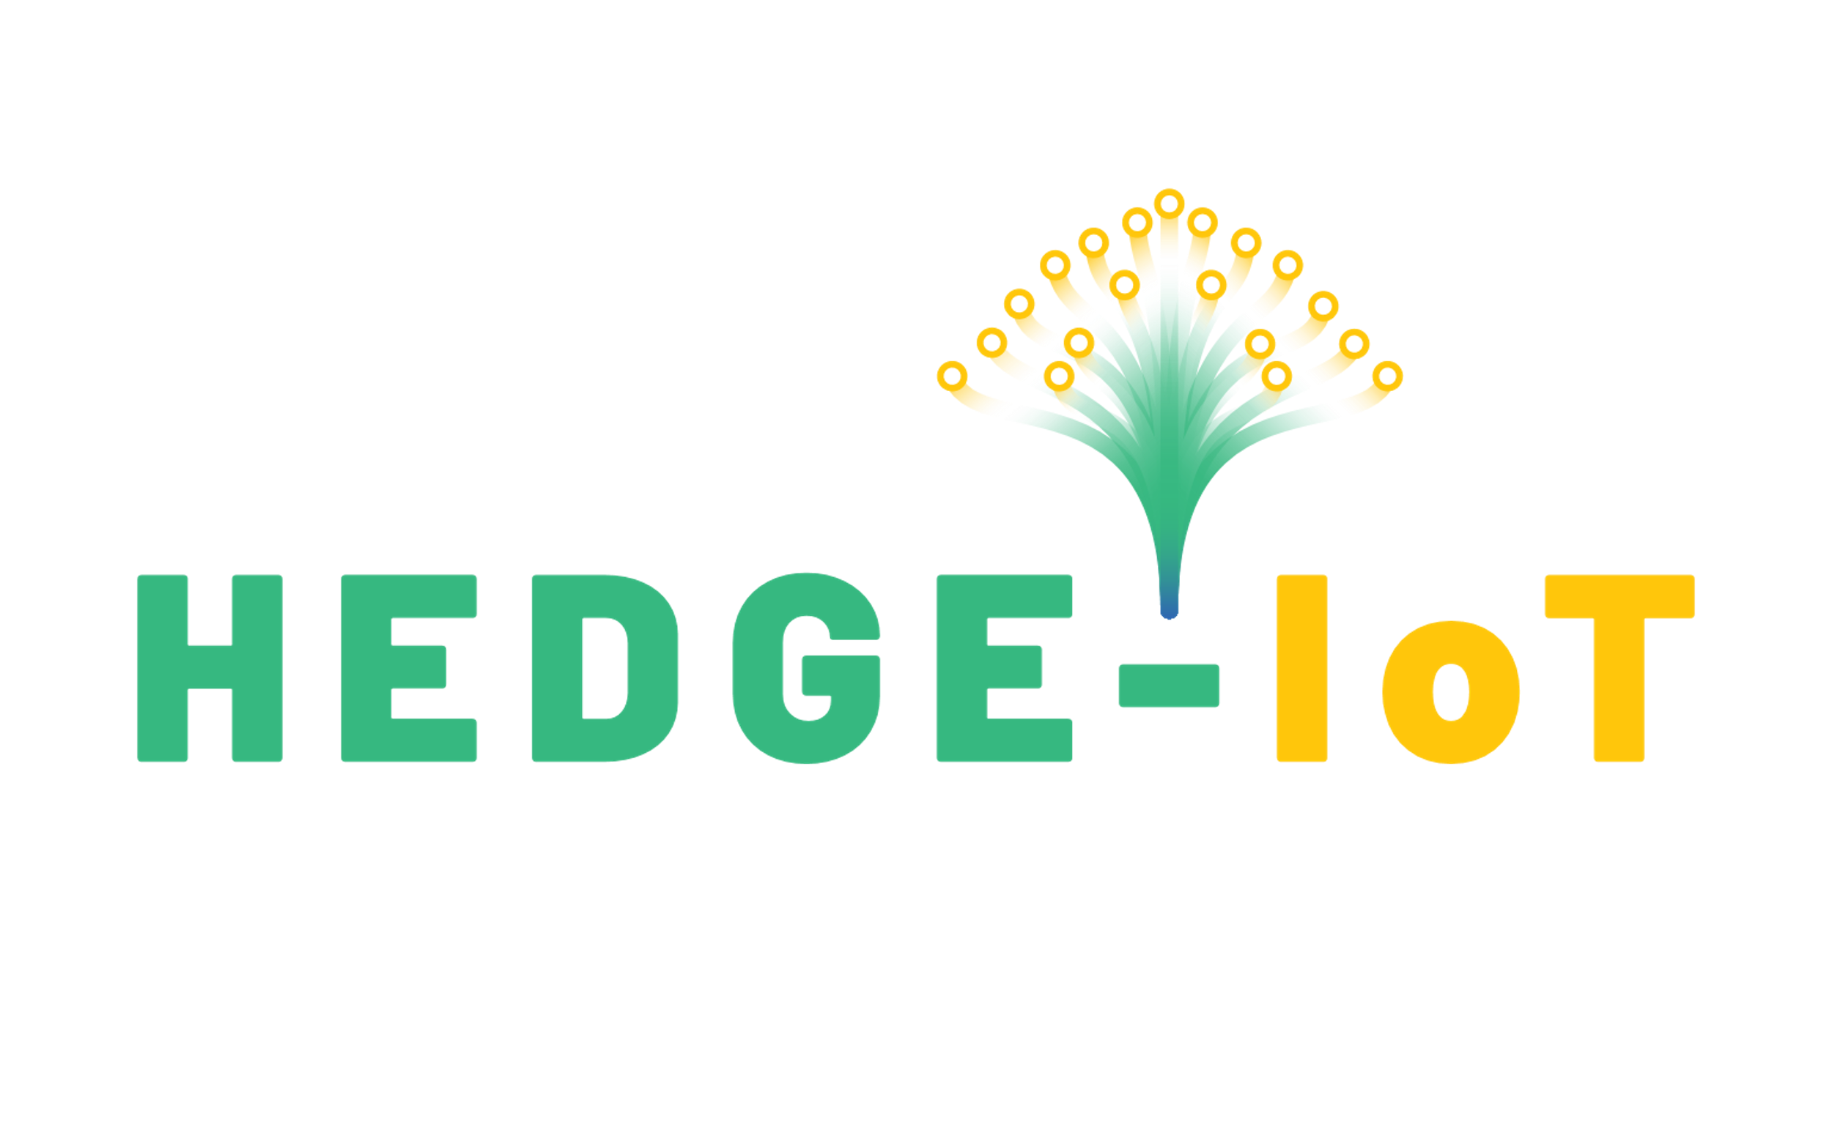
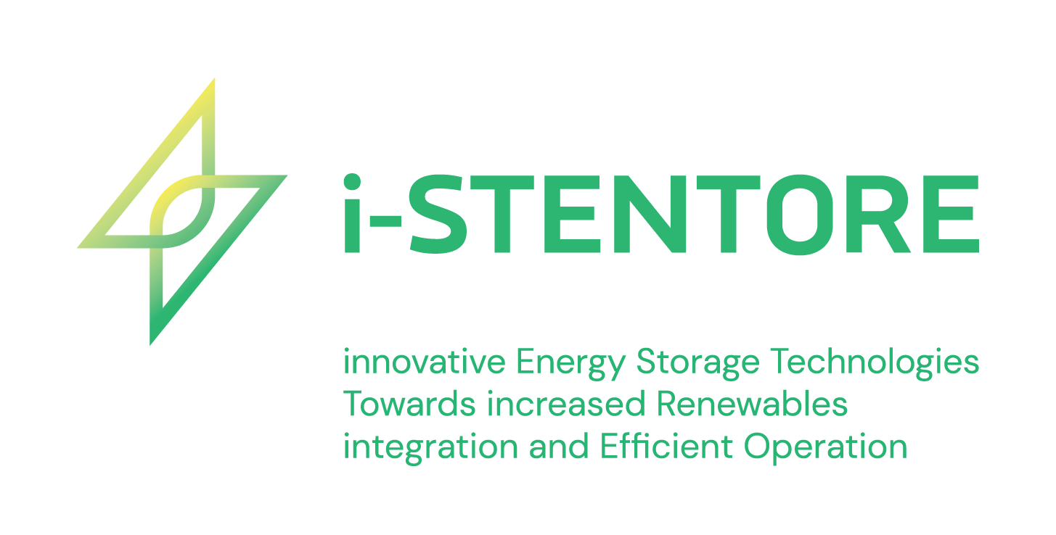

The Projects
Focuses on the deployment of integrated energy services across sectors and carriers, and the tokenisation of energy saving data in a public blockchain.
Aims to facilitate the creation of an effective, ICT-enabled, energy efficiency marketplace bringing together energy services and sustainable finance to accelerate the renovation rate of buildings by increasing the chances for projects to be financed.
It strives to transform traditional passive energy consumers into active energy citizens enabling them to take full control on their energy usage.
The objective of the project is to facilitate the orchestrated operation of energy systems with increased flexibility, through the HEDGE-IoT Reference Architecture.
Concentrates on how demand response and ICT can help manage energy consumption in residential buildings, optimizing energy use during peak demand times
It aims to develop and optimize hybrid storage solutions as active grid components, enhancing grid stability, efficiency, and renewable energy integration through a flexible, technology-agnostic framework and new business models.
Notes:
The Smart Energy Cluster includes several key projects addressing various aspects of energy management and efficiency. InEExS focuses on deploying integrated energy services across sectors using blockchain for energy savings tokenization. ENPOWER transforms passive energy consumers into active participants with full control over their usage. Dedalus aims to optimize energy consumption in residential buildings via demand response and ICT during peak times. ENERGATE works to create an ICT-enabled energy efficiency marketplace to support sustainable building renovations through finance facilitation. HEDGE-IoT facilitates orchestrated energy system operations with increased flexibility using its reference architecture. Lastly, i-STENTORE develops hybrid storage solutions as active grid components to improve stability, efficiency, and renewable integration, supported by flexible, technology-agnostic frameworks and innovative business models.

Slide 14



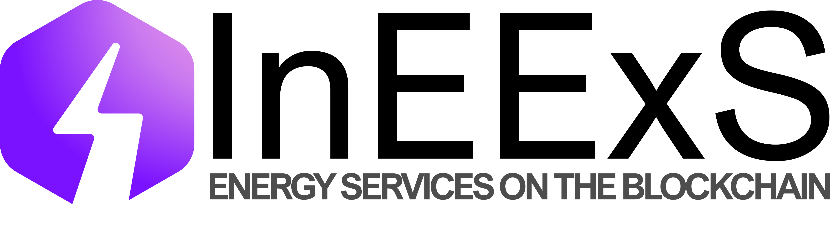




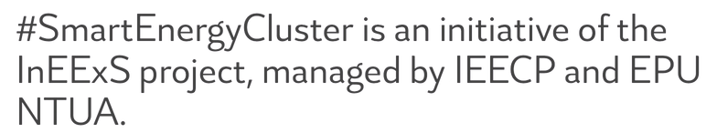


Follow us!
https://ieecp.org/projects/ineexs/
https://energate-project.eu/
#InEExS
@ENERGATE Project
/InEExS LIFE
ENERGATE Project
https://dedalus-horizon.eu/
https://hedgeiot.eu/
@DEDALUS_EU
@HEDGE-IoT
DEDALUS EU
HEDGE-IoT
https://www.enpower-project.eu/
https://istentore.eu/
@i-STENTORE_EU
ENPOWER
i-STENTORE
These projects receive funding from the European Commission Horizon and LIFE programmes.Views and opinions expressed are however those of the author(s) only and do not necessarily reflect those of the European Union or CINEA. Neither the European Union nor the granting authority can be held responsible for them.

Slide 15
kpapap@epu.ntua.gr; roberta@ieecp.org

Slide 16

Session 1 – Empowering Citizens in the Energy Transition: Innovative Models, Technologies & Communities
These projects receive funding from the European Commission Horizon and LIFE programmes.Views and opinions expressed are however those of the author(s) only and do not necessarily reflect those of the European Union or CINEA. Neither the European Union nor the granting authority can be held responsible for them.

Slide 17
Session 2 – Accelerating Energy Transition: Digital platforms, Storage Integration, and IoT Intelligence
These projects receive funding from the European Commission Horizon and LIFE programmes.Views and opinions expressed are however those of the author(s) only and do not necessarily reflect those of the European Union or CINEA. Neither the European Union nor the granting authority can be held responsible for them.

